Slide 1

OLYMPIC GAMES DATA ENGG. PROJECT
Databricks
PROJECT GUIDE:
Venkata S. Billa (DE Expert)
BY:
SARASWATHI LAKSHMANAN

Slide 2
Project Description & Objective
The Olympic Games Data Engineering Project aims to create a robust and scalable data infrastructure for managing and analyzing historical data related to the Olympic Games. This project is designed to support researchers, analysts, and sports enthusiasts in gaining valuable insights into the history of the Olympics, tracking athlete performance, and exploring various aspects of this global sporting event.

Slide 3









END TO END IMPLEMENTATIONS OF DE PIPELINE
Source
Ingestion / ETL
Storage / Analysis
BI
COPY INTO

Slide 4
END TO END IMPLEMENTATION
1
Source
Ingestion / ETL
Analysis
BI

Slide 5
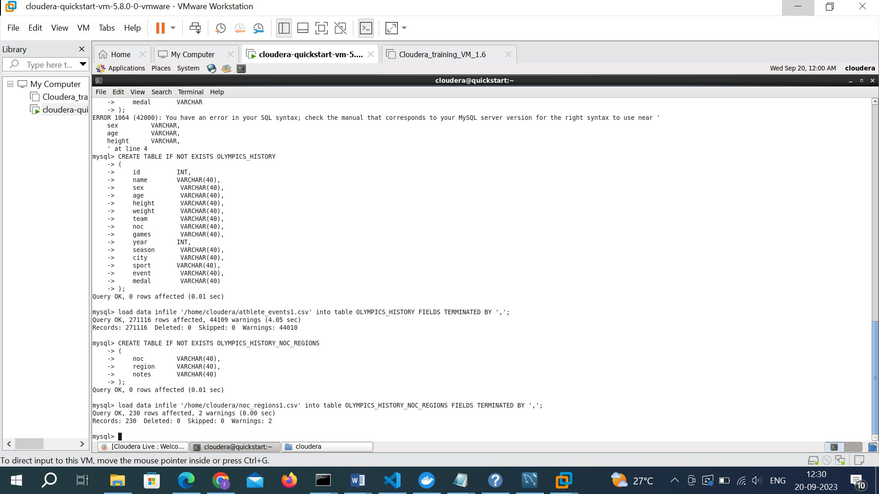
Step 1: Creating MySQL tables

Slide 6
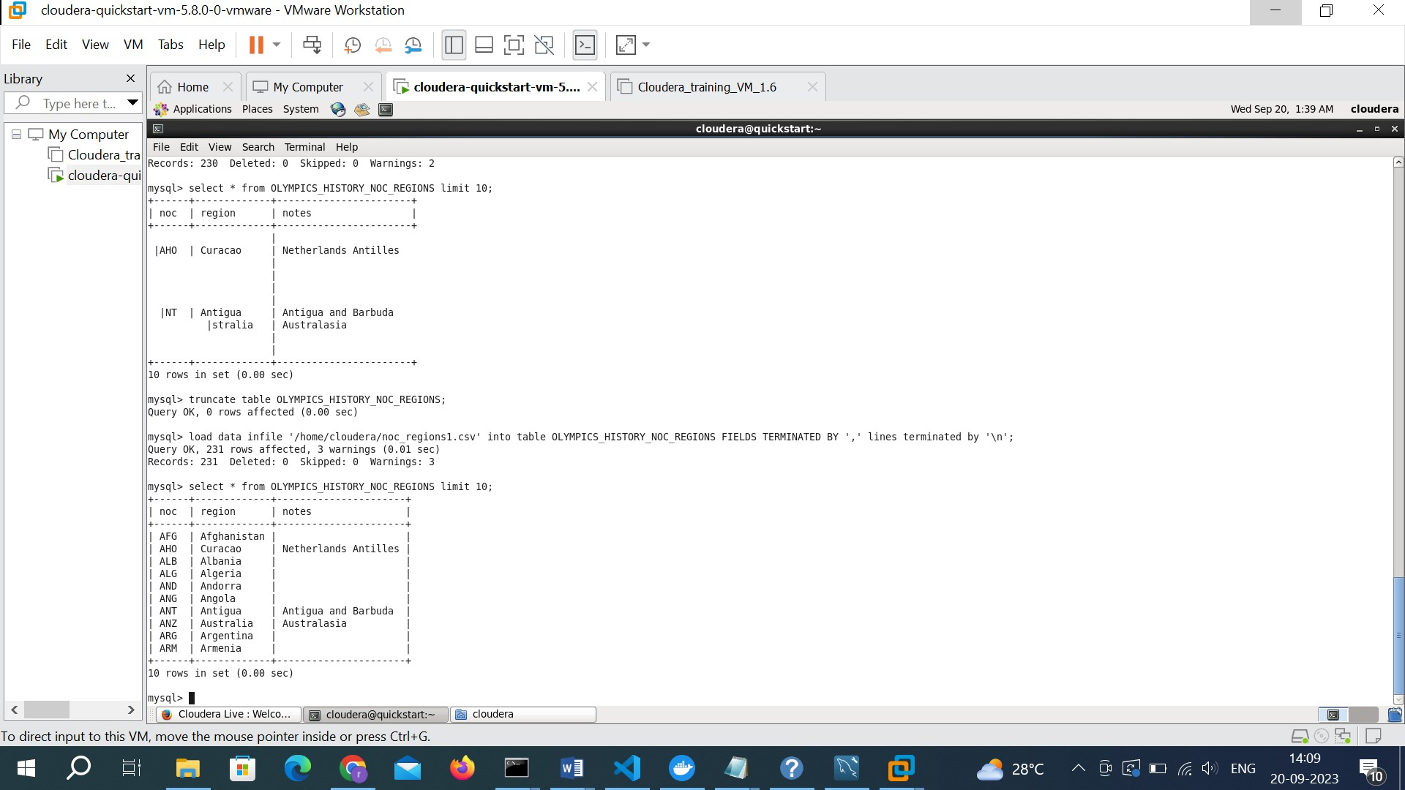
Step 2: Loading data into MySQL tables

Slide 7
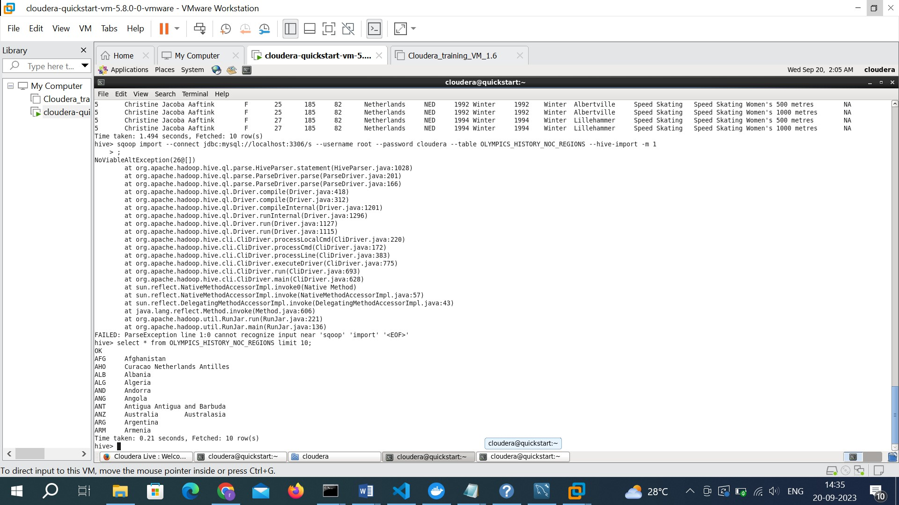
Step 3: Importing MySQL tables to hive

Slide 8
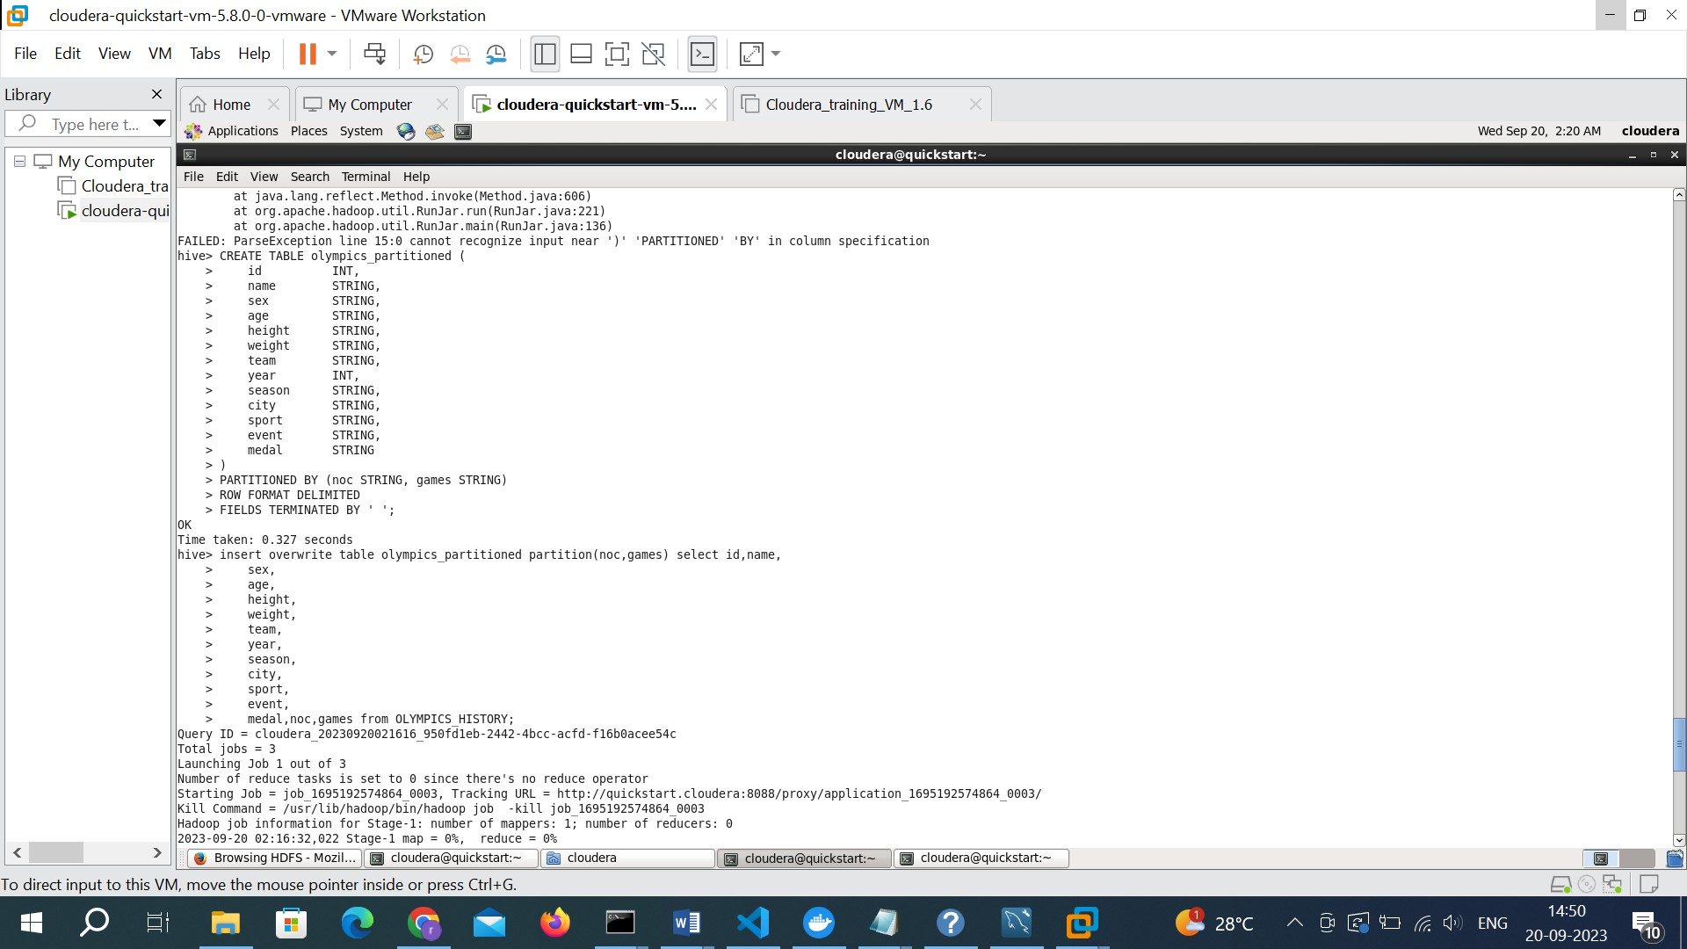
Step 4: Partitioned table creation in hive for optimized analysis

Slide 9
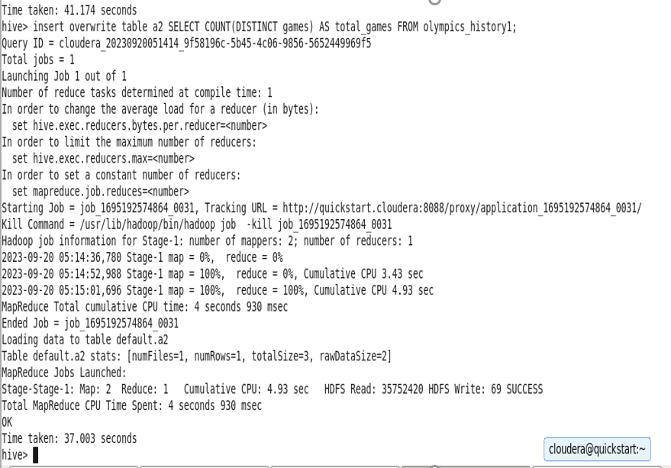
Q. How many Olympics games have been held?
CREATE EXTERNAL TABLE IF NOT EXISTS a2(
answer STRING
)
ROW FORMAT DELIMITED
FIELDS TERMINATED BY ' ‘;
insert overwrite table a2 SELECT COUNT(DISTINCT games) AS total_games FROM olympics_history1;

Slide 10
END TO END IMPLEMENTATION
2
Source
Ingestion / ETL
Analysis
BI
COPY INTO

Slide 11
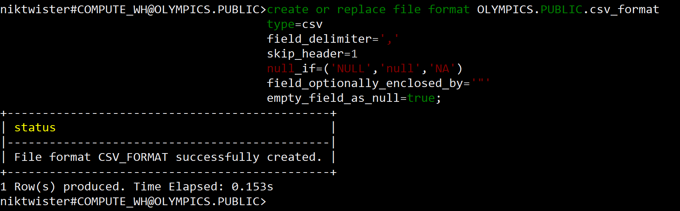
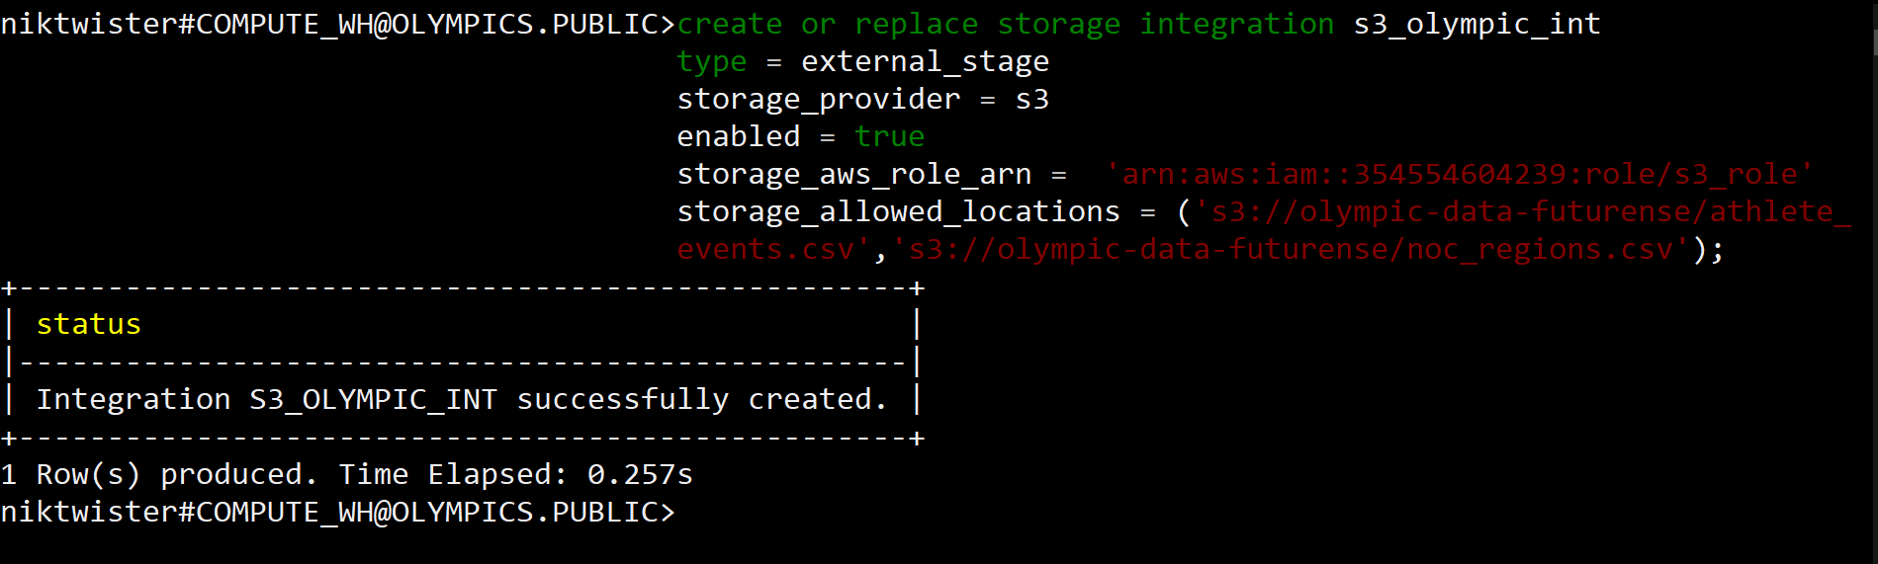
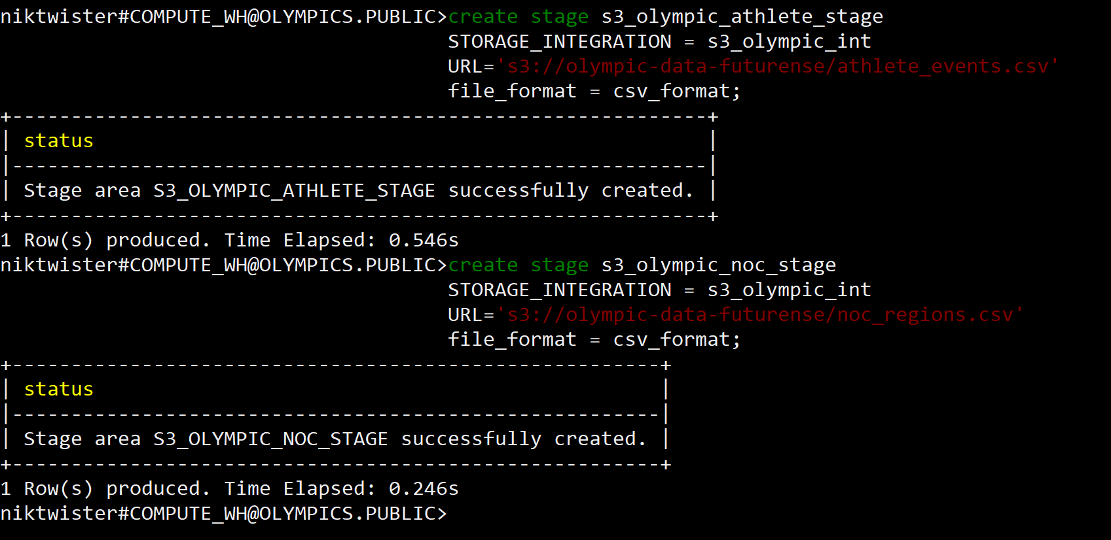
Creating file format
Creating storage integration
Creating stages

Slide 12
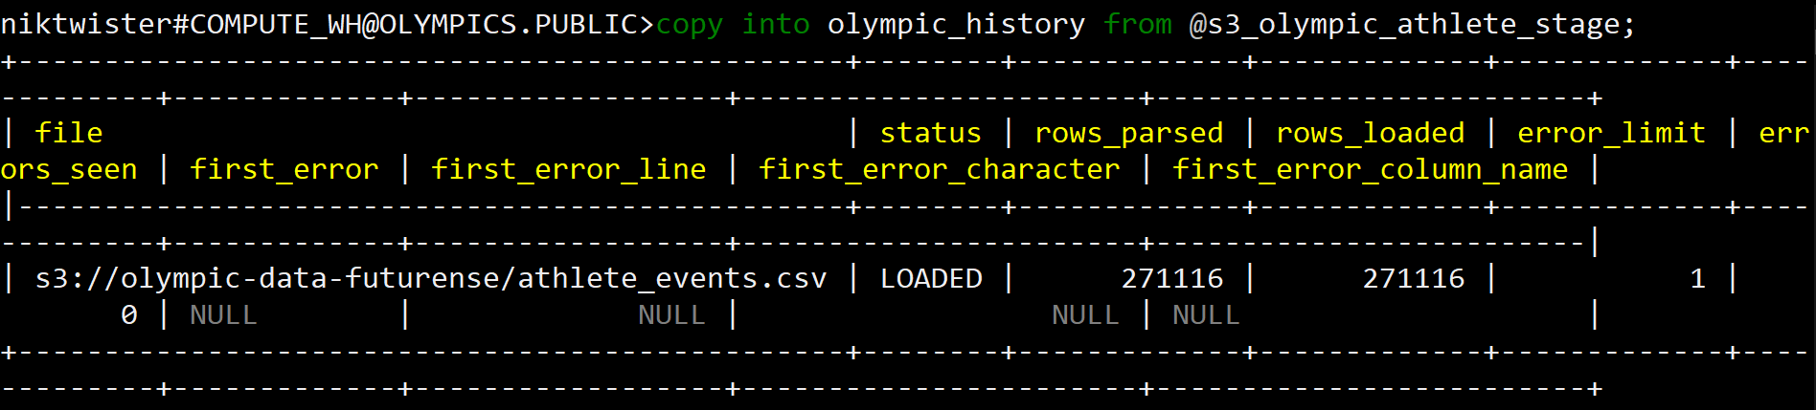
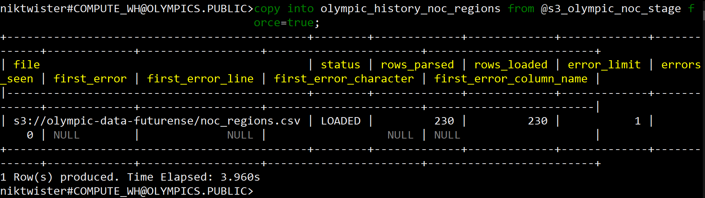
copy into olympic_history
copy into olympic_history_noc_regions

Slide 13
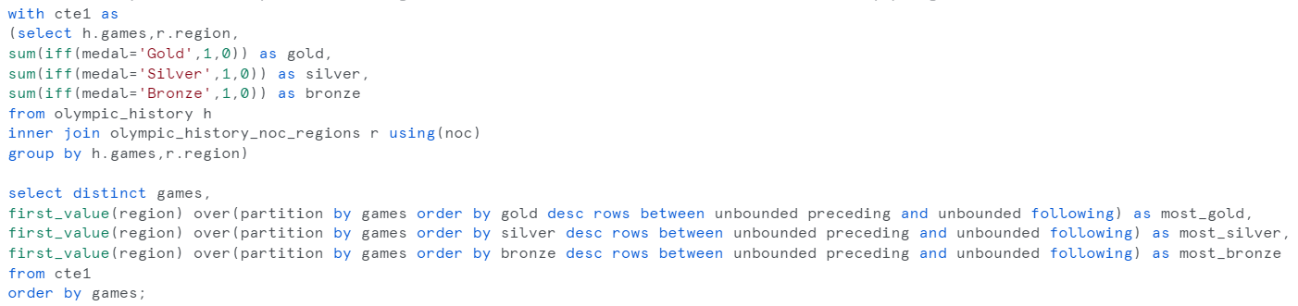
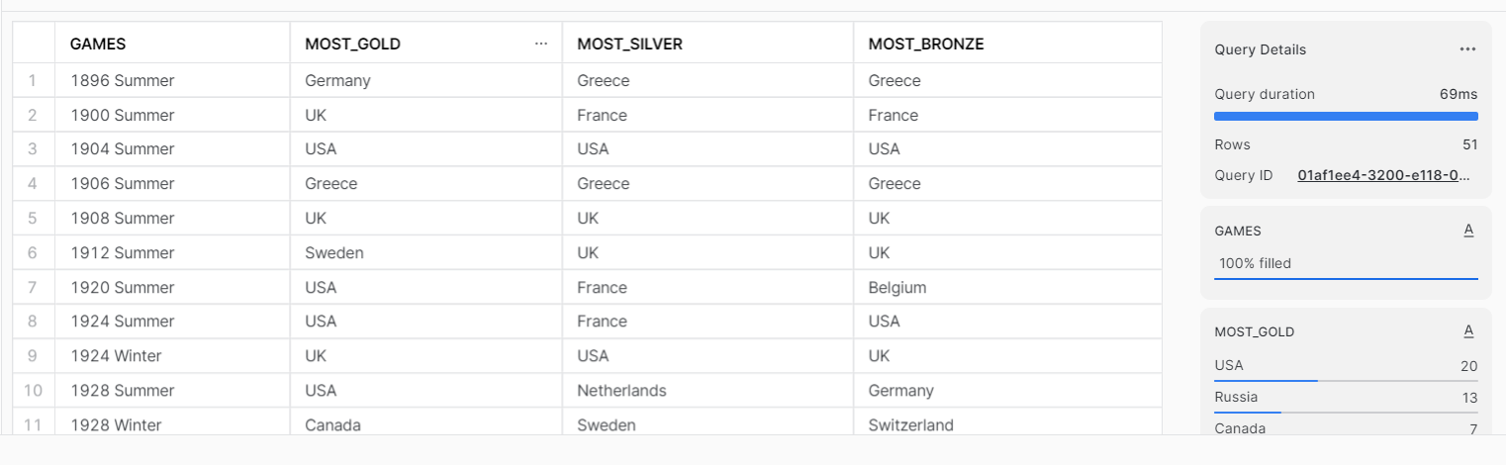
Q. Identify which country won the most gold, most silver and most bronze medals in each olympic games.
Output

Slide 14
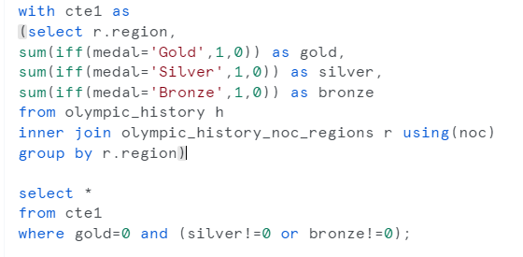
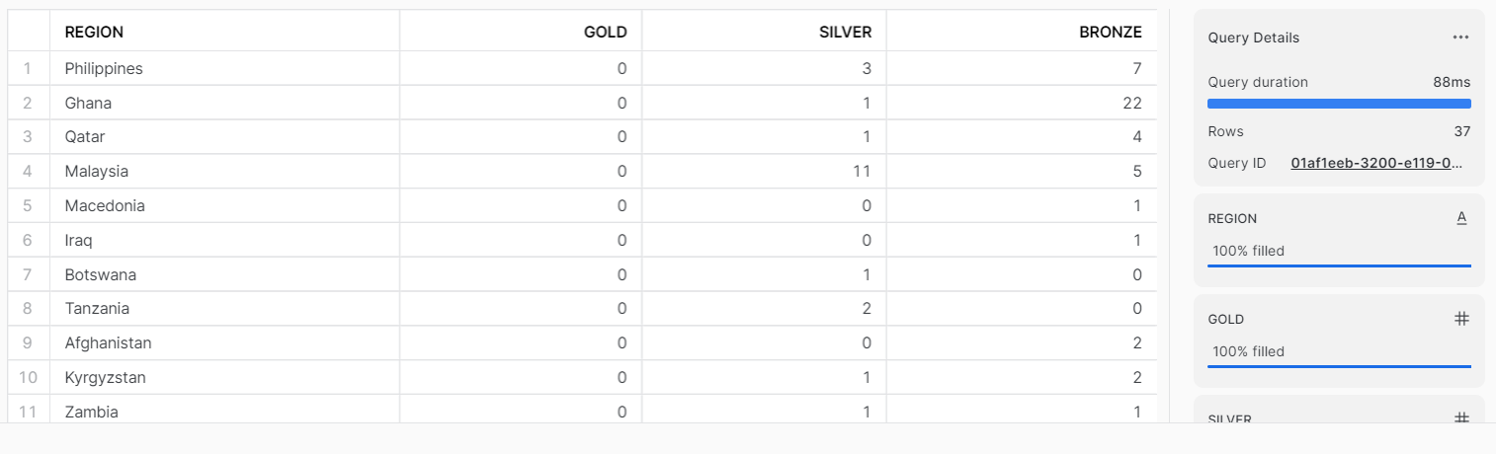
Q. Which countries have never won gold medal but have won silver/bronze medals?
Output

Slide 15
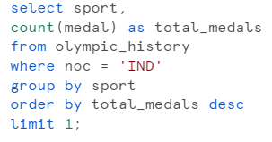
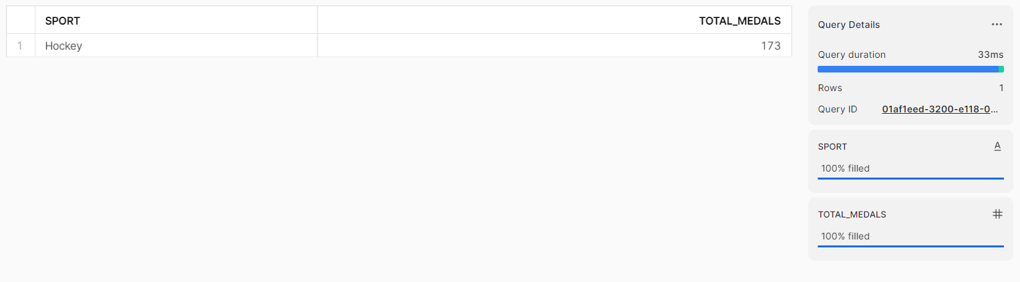
Q. In which Sport/event, India has won highest medals.
Output

Slide 16
END TO END IMPLEMENTATION
3
Source
Ingestion / ETL
Analysis
BI

Slide 17
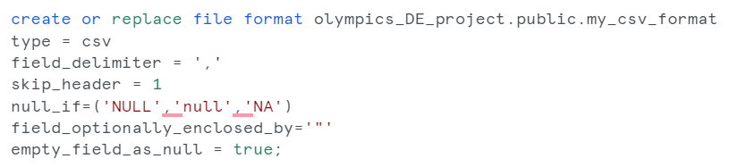
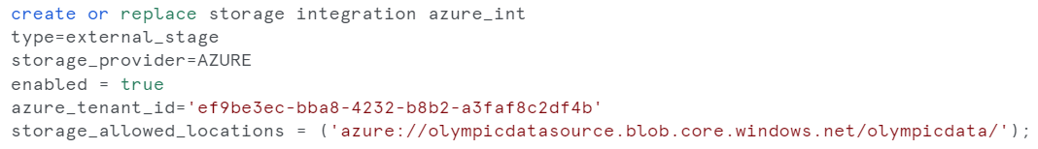
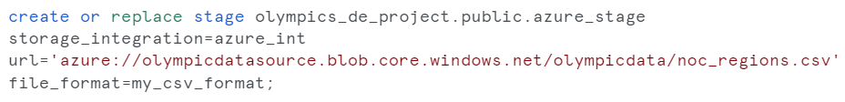
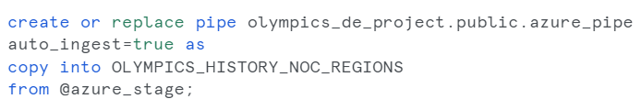
Creating file format
Creating storage integration
Creating stage
Creating snowpipe

Slide 18
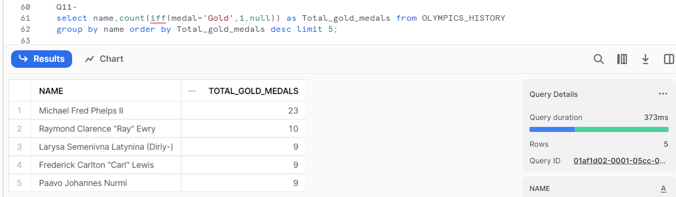
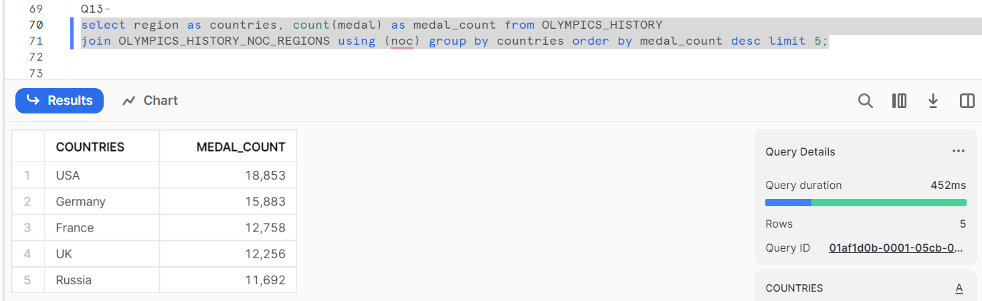
Q. Fetch the top 5 athletes who have won the most gold medals.
Q. Fetch the top 5 most successful countries in Olympics. Success is defined by no of medals won.

Slide 19
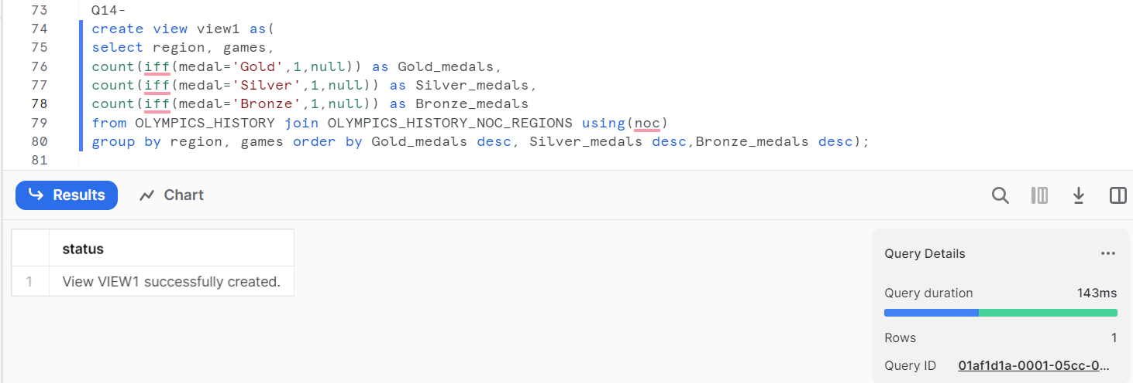
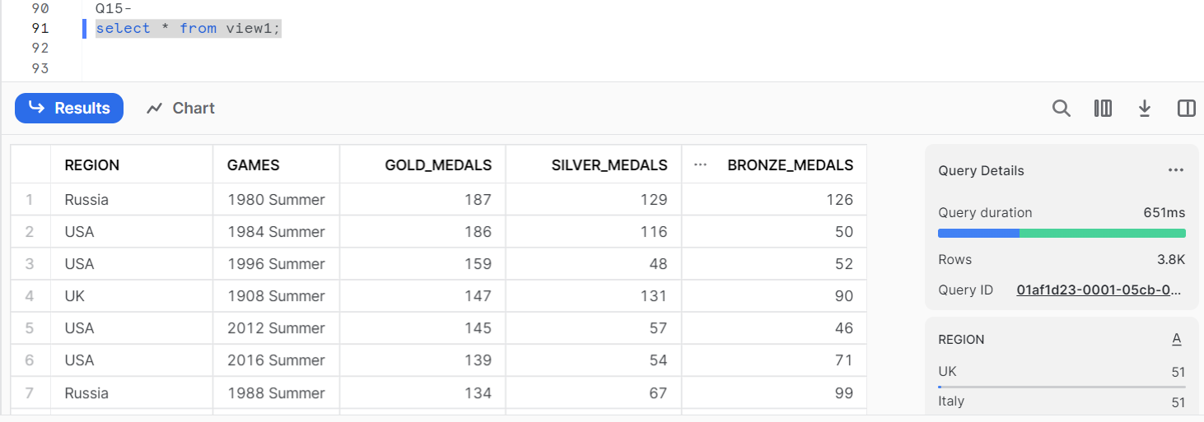
Q. List down total gold, silver and bronze medals won by each country corresponding to each olympic games.
Output

Slide 20
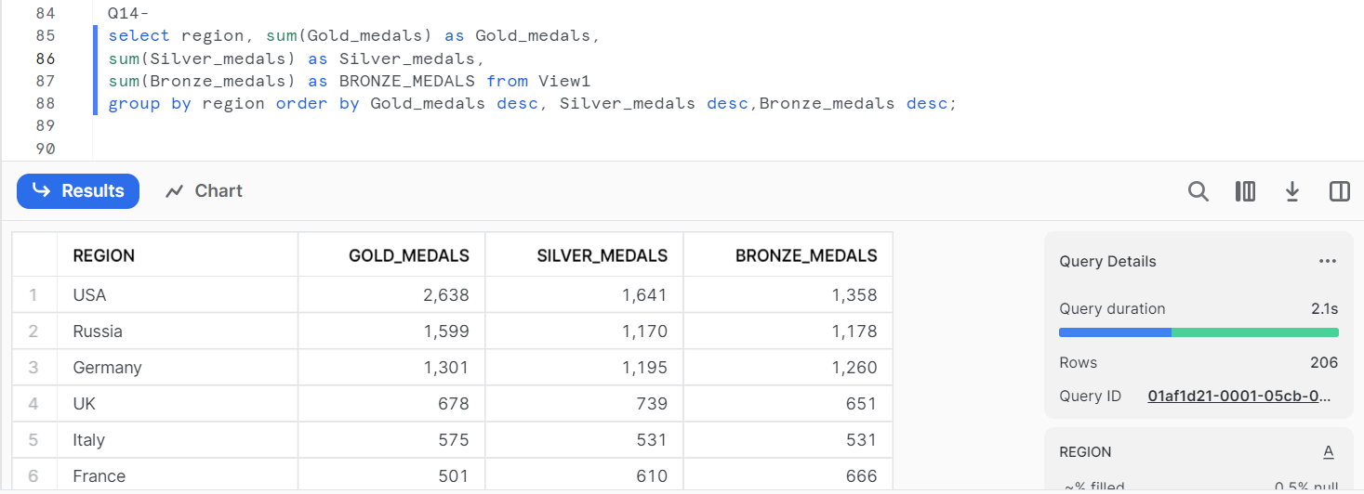
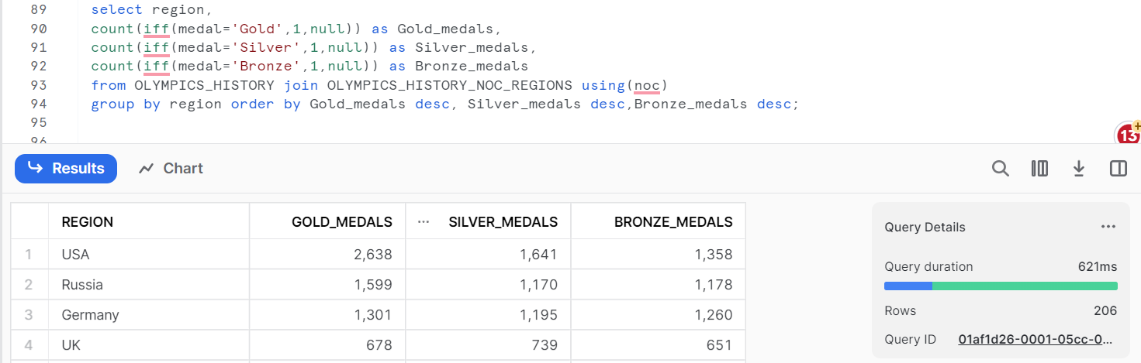
Q. List down total gold, silver and bronze medals won by each country.
Output with previously created view
Output without previously created view

Slide 21
END TO END IMPLEMENTATION
4
Source
Ingestion / ETL
Analysis
BI

Slide 22
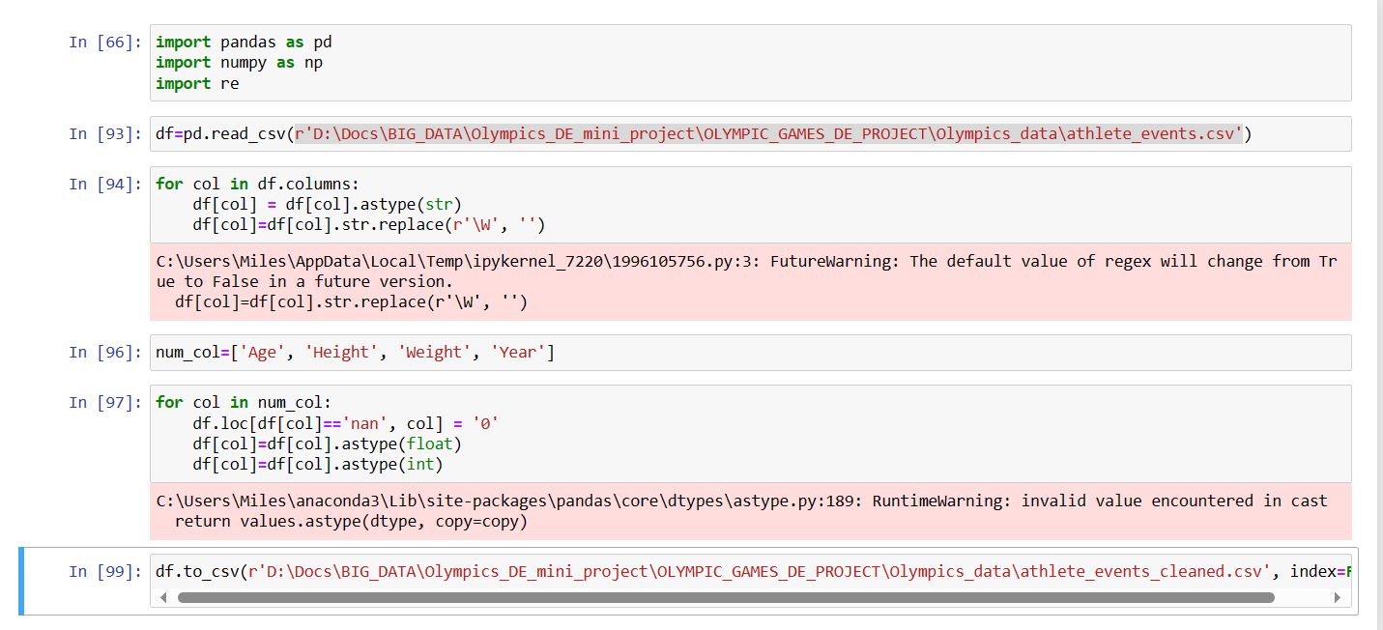
Cleaning Data

Slide 23
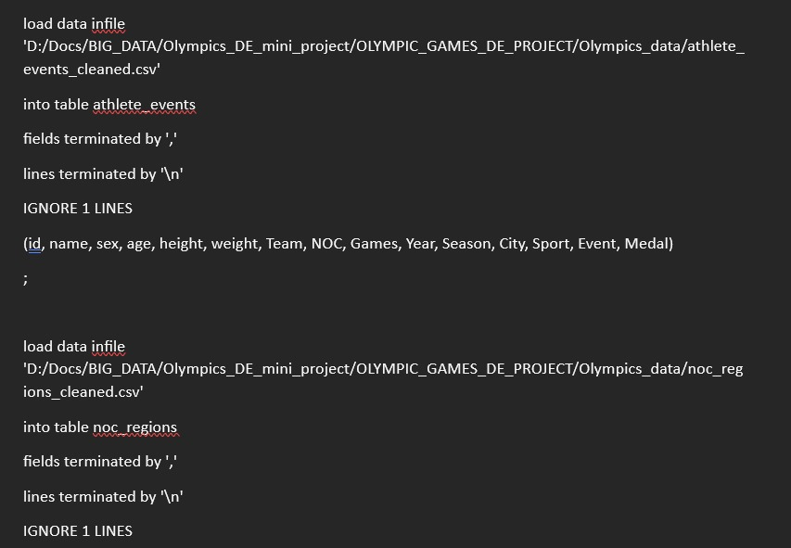
Importing Data into MySQL Server

Slide 24
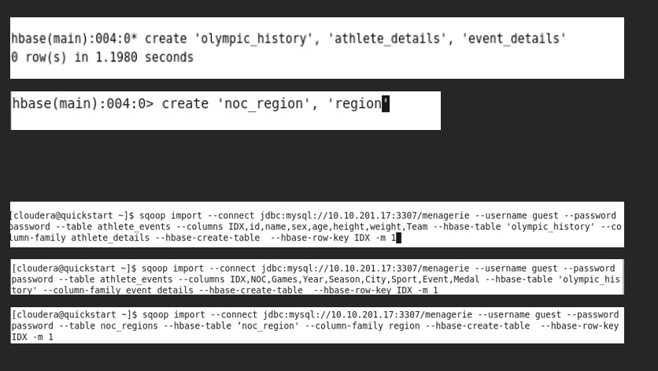
Creating table in HBase and Importing data from remote MySQL server

Slide 25
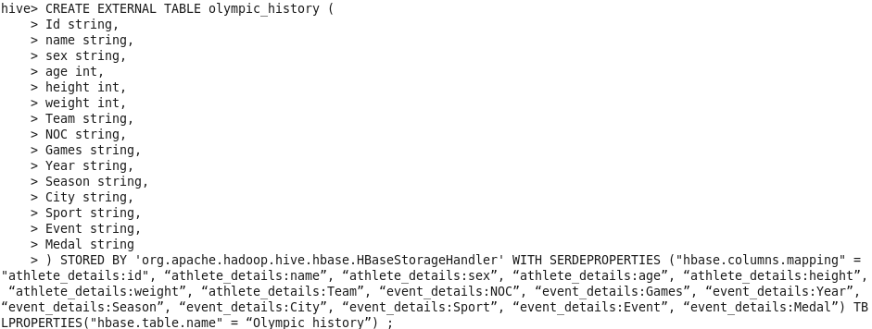
Connecting an HIVE table to already existing HBase table

Slide 26
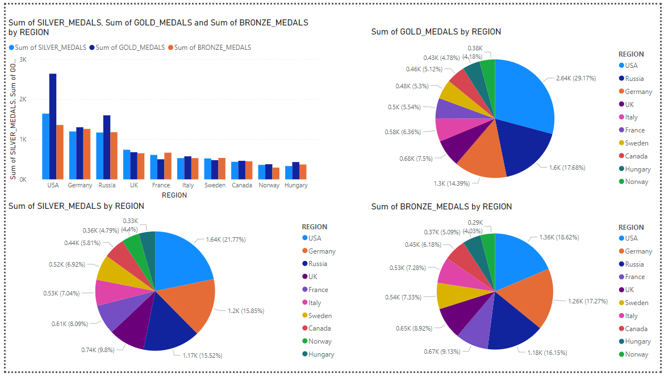
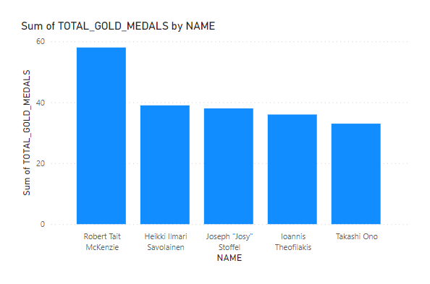
POWER BI DASHBOARD

